Slide 1

Orchestrator
Introduction
Eyal Schwartz, PM
Bot Framework
Microsoft

Slide 2
Agenda
What is Orchestrator
What are the advantages of Orchestrator
How to use Orchestrator
How to send feedback
Resources

Slide 3
What is Orchestrator?
Natural Language Processing for Microsoft Bot Framework
Machine Learning Technology: Transformers
Used for intent recognition
Route utterances to subsequent bot skills or cognitive services
References:
Overview
Natural Language Representation Models

Slide 4
What are the advantages of Orchestrator?
No ML or NLP expertise required.
No model training is required.
Local Cognition. Not a remote service.
Improved classification with fewer training examples.
Multilingual models: (E)FIGSPC+ with auto-recognition
High performance
Regional affinity (it’s local - part of the bot)
Privacy/compliance advantages
COGS savings: Light CPU usage, no network transactions (though more memory)
Better imbalance resiliency

Slide 5
How to use Orchestrator?
Use in Code-First or Composer development environments
Manage and tune using BF CLI
Detect intent from user utterance
Trigger subsequent expert skill
Route (“dispatch”) to LUIS or QnAMaker for further language processing
Reference: Samples

Slide 6
Sample CLI Usage
set BLU=generated\schoolnavigatorbot.en-us.blu
set LUFILE=schoolnavigatorbot.en-us.lu
set TESTFILE=schoolnavigatorbot.test.lu
@echo Create orchestrator snapshot
@rem Only need to retrieve model once
call bf orchestrator:basemodel:get --out ./model
call bf orchestrator:create --model ./model --out ./generated --in %LUFILE%
@echo sample orchestrator query
bf orchestrator:query --in %BLU% --model model --query "need admissions info"
@echo running orchestrator test...
call bf orchestrator:test --in %BLU% --model ./model --test %TESTFILE% --out report
>> %LUFILE%
# Sports
tell me about the Athletics program
Info about sports- where can i find the gym?
i want to play basketball
…
>> %TESTFILE%
# Sports
what is available in sports?
do you have an athletic program?
where's the gym?
…
>bf orchestrator:query --in %BLU% --model model --query %QUERY%
[
{
"closest_text": "join sports team",
"score": 0.9370985194710499,
"label": {
"name": "Sports",
"label_type": 1,
"span": {
"length": 30,
"offset": 0
…

Slide 7
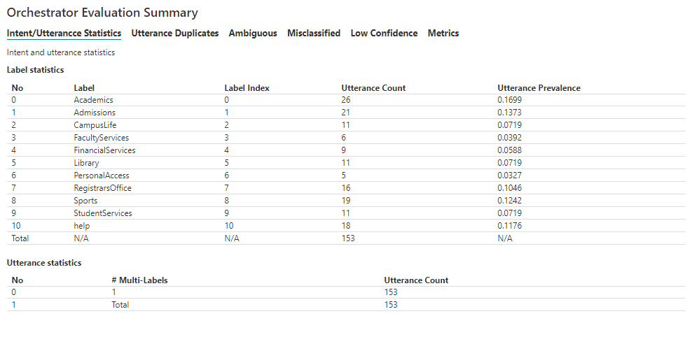
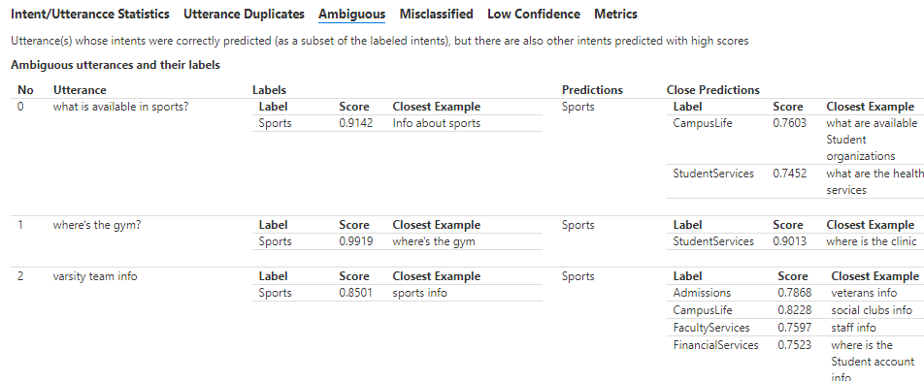
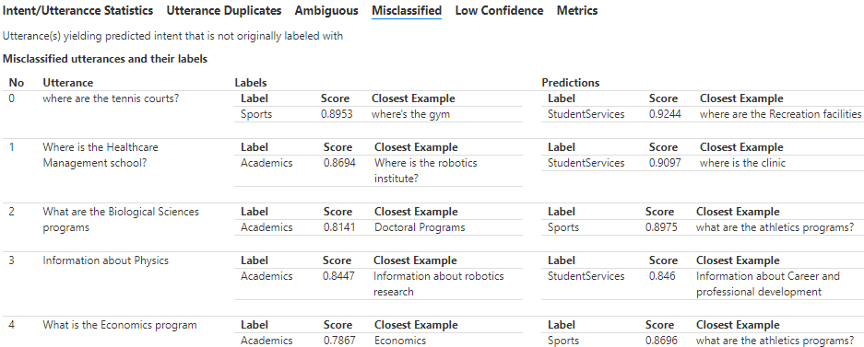
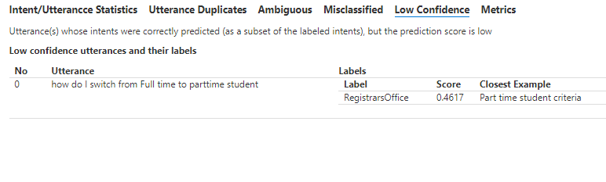
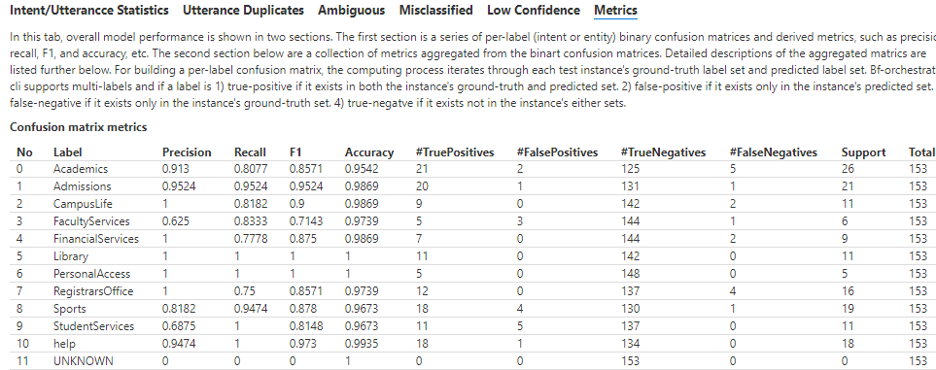
Report
Extensive Report
Analyze & add samples to optimize
Simple views
ML Data Scientist views

Slide 8
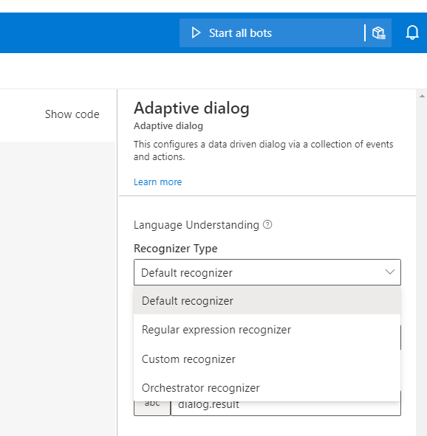
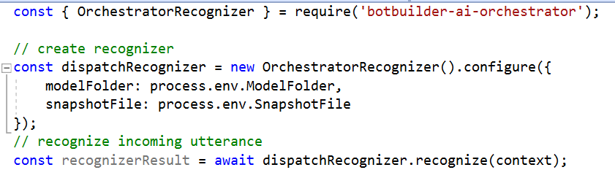
User Experience
SDK Code
Composer
CLI: Retrieve base model
CLI: Author LU label file
CLI: Create snapshot file
CLI: Evaluate
C#/JS:
Use Recognizer for Intent-only (e.g. dispatch/routing scenarios)
Install Orchestrator package
Select Orchestrator in LU Recognizer drop down
Adjust LU examples, Run
Deployment contains Orchestrator assets
Tune/Evaluate – use CLI
(Preferred development path)

Slide 9
Status
Preview now: some limitations
Intents; Composer performance
GA around ~BUILD timeframe
Team support for early adopters’ feedback

Slide 10
Demo
CLI usage
Composer Bot
Code Review

Slide 11
How to send feedback?
File Github Issues
CLI: https://github.com/microsoft/botframework-cli/issues
Samples: https://github.com/microsoft/BotBuilder-Samples/issues
Composer: https://github.com/microsoft/BotFramework-Composer/issues
SDK: https://github.com/microsoft/botframework-sdk/issues

Slide 12
Resources
High level introduction: https://aka.ms/bf-orchestrator
Tech overview
API reference
Roadmap
BF CLI Orchestrator plugin
C# samples
NodeJS samples
BF Orchestrator Command Usage

Slide 13
Thanks
Q&A

Slide 14
Backup

Slide 15
Migration Path
Retrieve LUIS/QnA Maker models
Retrieve Orchestrator base model
Combine into a snapshot (.blu) file
Evaluate & adjust with test examples
See also bf orchestrator:add for simpler path
See Also: https://aka.ms/bf-orchestrator

